Slide 1
Microsoft Word: Creating an Advertising Flyer

Slide 2
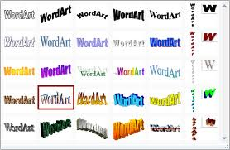
MS Word 2017 Skills
Word Art
Text Boxes
Inserting Graphics
Text Wrapping
Alignment
Text Effects

Slide 3
Creating an Effective Flyer
Headline
Picture/Graphic
Copy
Logo
Contact Information

Slide 4
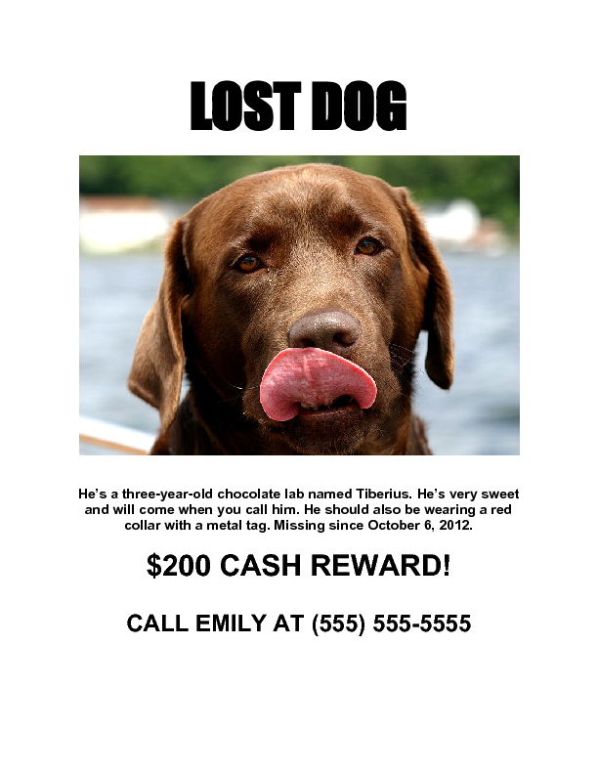
Headline
Must capture attention of targeted audience
Catchy phrase using few words
Font is large enough to read
Font can be easily read
ATTENTION GRABBING!

Slide 5
Picture/Graphic
Maintain theme with image
One large picture is better than many small pictures
Picture needs to be clear and not blurry

Slide 6
Copy (Content)
Explain the event
DO NOT BE WORDY
Use bullet points when possible
Paragraphs should be very short
Limit to 2 fonts for readability

Slide 7
Contact
Include phone number if necessary
Include address if the reader will need it

Slide 8
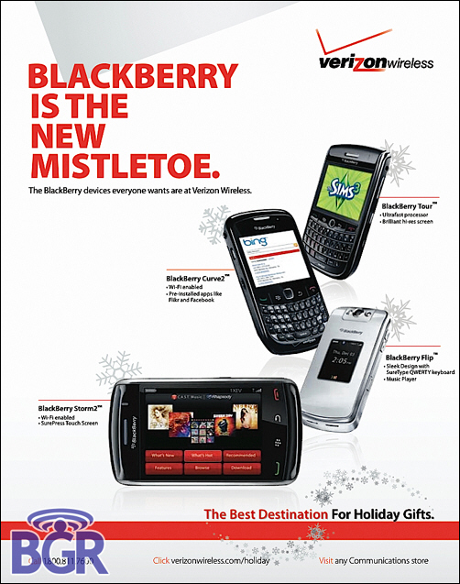
Logo

Slide 9
Good vs Bad

