Slide 1
Learning Objectives
LO1 Prepare an unadjusted trial balance.
LO2 Adjust supplies and prepaid insurance.
© 2014 Cengage Learning. All Rights Reserved.

Slide 2
Adjusting Account Balances
Lesson 15-1
LO1
Some general ledger accounts need to be brought up to date before financial statements are prepared.
Remember Supplies Expense & Insurance Expense?
Adjusting entries are used to bring a general ledger account up to date.

Slide 3
Preparing an Unadjusted Trial Balance
Lesson 15-1
LO1
The first step in preparing adjusting entries is to prepare a trial balance.
A trial balance prepared before adjusting entries are posted is called an unadjusted trial balance.

Slide 4
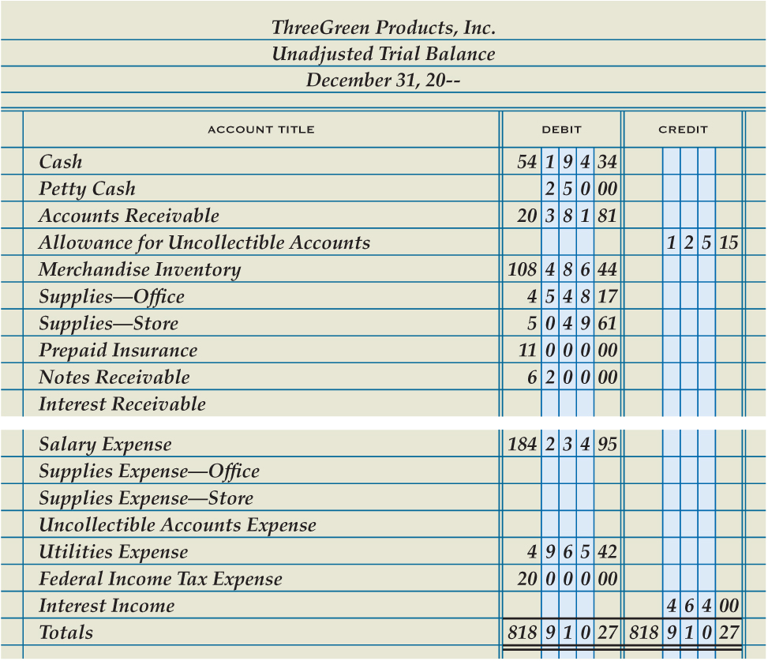
Preparing an Unadjusted Trial Balance
Lesson 15-1
LO1
1
Write account titles
2
Enter account balances
3
Total, prove, and rule column totals

Slide 5
Recording Adjusting Entries for Supplies
Lesson 15-1
LO2
Four questions are asked to analyze the adjustments for supplies.
What are the balances of the accounts being adjusted?
What should the balances be for these accounts?
What must be done to correct the account balances?
What adjusting entries are made?

Slide 6
Recording Adjusting Entries for Supplies
Lesson 15-1
LO2
Supplies Expense—Office
Adj. 3,938.17
Supplies—Office
Dec. 31 Bal. 4,548.17
(New Bal. 610.00)
Adj. 3,938.17
Supplies Expense—Store
Adj. 4,584.61
Supplies—Store
Dec. 31 Bal. 5,049.61
(New Bal. 465.00)
Adj. 4,584.61

Slide 7
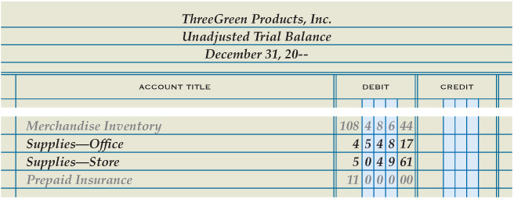
Recording Adjusting Entries for Supplies
Lesson 15-1
LO2

Slide 8
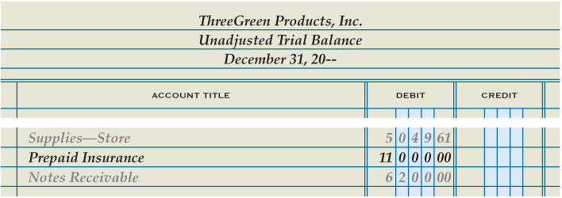
Recording an Adjusting Entry for Prepaid Insurance
Lesson 15-1
LO2
Insurance Expense
Adj. 8,200.00
Prepaid Insurance
Dec. 31 Bal. 11,000.00
(New Bal. 2,800.00)
Adj. 8,200.00

Slide 9
Lesson 15-1 Audit Your Understanding
Lesson 15-1
1. Which accounts are used for the adjustment to office supplies?
ANSWER
Supplies Expense—Office
Supplies—Office

Slide 10
Lesson 15-1 Audit Your Understanding
Lesson 15-1
2. Which accounts are used for the adjustment to prepaid insurance?
ANSWER
Insurance Expense
Prepaid Insurance

Slide 11
Lesson 15-1
Aplia

Slide 12
Learning Objectives
LO3 Adjust merchandise inventory.
LO4 Adjust interest receivable.
© 2014 Cengage Learning. All Rights Reserved.

Slide 13
Recording an Adjusting Entry for Merchandise Inventory
Lesson 15-2
LO3
The amount of inventory on hand at the beginning of a fiscal period is called beginning inventory.
During the period, merchandise is purchased and merchandise is sold.
To determine how much merchandise remains in inventory at the end of the period, a physical inventory is conducted.
The actual count of merchandise at the end of a fiscal period is called ending inventory.

Slide 14
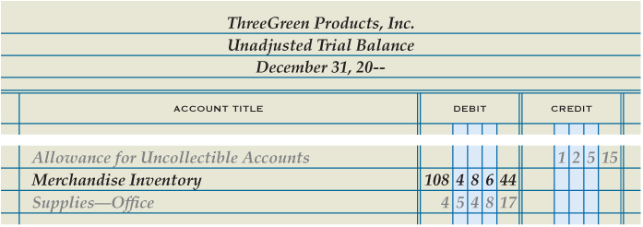
Recording an Adjusting Entry for Merchandise Inventory
Lesson 15-2
LO3
Merchandise Inventory
Dec. 31 Bal. 108,486.44
(New Bal. 102,838.00)
Adj. 5,648.44
Income Summary
Adj. 5,648.44

Slide 15
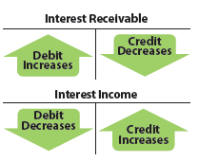
Journalizing the Adjusting Entry for Interest Receivable -- Interest is earned daily
Lesson 15-2
LO3
Interest earned but not yet received is called accrued interest income.
Interest Receivable is an asset account.
Interest Income is a revenue account.

Slide 16
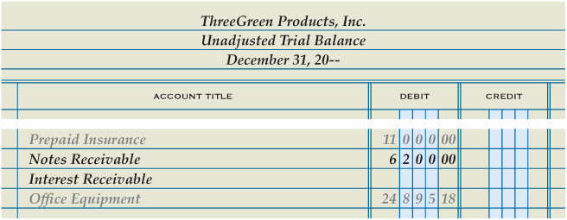
Journalizing the Adjusting Entry for Interest Receivable
Lesson 15-2
LO3
Interest Receivable
Adj. 93.00
Interest Income
Dec. 31 Bal. 464.00
New Bal. 93.00
(New Bal. 557.00)
1
Debit Interest Receivable
2
Credit Interest Income

Slide 17
Lesson 15-2 Audit Your Understanding
Lesson 15-2
1. How is the amount of merchandise inventory on hand at the end of the fiscal year determined?
ANSWER
A physical inventory is conducted.

Slide 18
Lesson 15-2 Audit Your Understanding
Lesson 15-2
2. What adjusting entry is recorded when the ending merchandise inventory is greater than the beginning value?
ANSWER
Debit Merchandise Inventory
Credit Income Summary

Slide 19
Lesson 15-2 Audit Your Understanding
Lesson 15-2
3. How often is revenue earned on an outstanding note receivable?
ANSWER
Daily

Slide 20
Lesson 15-2
Aplia

Slide 21
Learning Objectives
LO5 Calculate depreciation expense using the straight-line method.
LO6 Adjust accumulated depreciation.
© 2014 Cengage Learning. All Rights Reserved.

Slide 22
Categories of Assets
Lesson 15-3
LO5
Most businesses use several broad categories of assets in their operations.
Cash and other assets expected to be exchanged for cash or consumed within a year are called current assets.
Physical assets that will be used for a number of years in the operation of a business are called plant assets.

Slide 23
Depreciating Plant Assets
Lesson 15-3
LO5
A loss in the usefulness of a plant asset as a result of wear or obsolescence is called depreciation.
To match revenue with the expenses used to earn the revenue, the cost of a plant asset must be expensed over the asset’s useful life.
The portion of a plant asset’s cost that is transferred to an expense account in each fiscal period during that asset’s useful life is called depreciation expense.

Slide 24
Depreciating Plant Assets
Lesson 15-3
LO5
Three factors are considered in calculating the annual amount of depreciation expense for a plant asset:
Original cost
Salvage value
Useful life

Slide 25
Depreciating Plant Assets— Original Cost
Lesson 15-3
LO5
The original cost of a plant asset includes all costs paid to make the asset usable to a business.
These costs include the price of the asset plus delivery and any necessary installation costs.

Slide 26
Depreciating Plant Assets— Salvage Value
Lesson 15-3
LO5
An estimate of the amount that will be received for an asset at the time of its disposal is called its salvage value.
Salvage value may also be referred to as residual value or scrap value.
Since salvage value cannot be known when the asset is bought, it must be estimated.

Slide 27
Depreciating Plant Assets— Useful Life
Lesson 15-3
LO5
The period of time over which an asset contributes to the earnings of a business is called its useful life.
The total amount of depreciation expense is distributed over the estimated useful life of a plant asset.
Two factors affect the useful life of a plant asset:
Physical depreciation
Functional depreciation

Slide 28
Straight-line Depreciation
Lesson 15-3
LO5
Recording an equal amount of depreciation expense for a plant asset in each year of its useful life is called the straight-line method of depreciation.
Original Cost | − | Estimated Salvage Value | = | Estimated Total Depreciation Expense
$2,500.00 | − | $500.00 | = | $2,000.00
Estimated Total Depreciation Expense | ÷ | Years of Estimated Useful Life | = | Annual Depreciation Expense
$2,000.00 | ÷ | 5 | = | $400.00

Slide 29
Accumulated Depreciation
Lesson 15-3
LO6
The total amount of depreciation expense that has been recorded since the purchase of a plant asset is called accumulated depreciation.
20X2 Accumulated Depreciation | + | 20X3 Depreciation Expense | = | 20X3 Accumulated Depreciation
$800.00 | + | $400.00 | = | $1,200.00

Slide 30
Book Value
Lesson 15-3
LO6
The original cost of a plant asset minus accumulated depreciation is called the book value of a plant asset.
Original Cost | − | 20X3 Accumulated Depreciation | = | Ending 20X3 Book Value
$2,500.00 | − | $1,200.00 | = | $1,300.00

Slide 31
Journalizing the Adjusting Entry for Accumulated Depreciation
Lesson 15-3
LO6
Office Equipment
Dec. 31 Bal. 24,895.18
Depreciation Expense—Office Equipment
Adj. 7,485.00
Accumulated Depreciation—Office Equipment
Dec. 31 Bal. 6,189.00
Adj. 7,485.00
(New Bal. 13,674.00)
Store Equipment
Dec. 31 Bal. 59,148.11
Depreciation Expense—Store Equipment
Adj. 9,830.00
Accumulated Depreciation—Store Equipment
Dec. 31 Bal. 8,495.00
Adj. 9,830.00
(New Bal. 18,325.00)

Slide 32
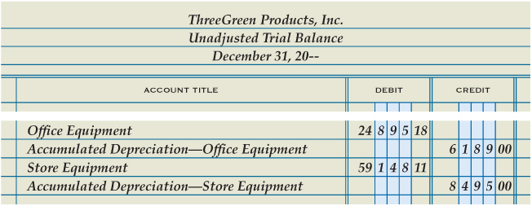
Journalizing the Adjusting Entry for Accumulated Depreciation
Lesson 15-3
LO6
1
Debit Depreciation Expense—Office Equipment and credit Accumulated Depreciation—Office Equipment
2
Credit Accumulated Depreciation—Office Equipment

Slide 33
Lesson 15-3 Audit Your Understanding
Lesson 15-3
1. What are two categories of assets?
ANSWER
Current assets
Plant assets

Slide 34
Lesson 15-3 Audit Your Understanding
Lesson 15-3
2. What three factors are used to calculate a plant asset’s annual depreciation expense?
ANSWER
Original cost, salvage value, and useful life

Slide 35
Lesson 15-3 Audit Your Understanding
Lesson 15-3
3. What plant asset account does not have a contra account for accumulated depreciation?
ANSWER
Land

Slide 36
Lesson 15-3
Aplia

Slide 37
Learning Objectives
LO7 Post adjusting entries.
LO8 Adjust federal income tax payable.
LO9 Prepare an adjusted trial balance.
© 2014 Cengage Learning. All Rights Reserved.

Slide 38
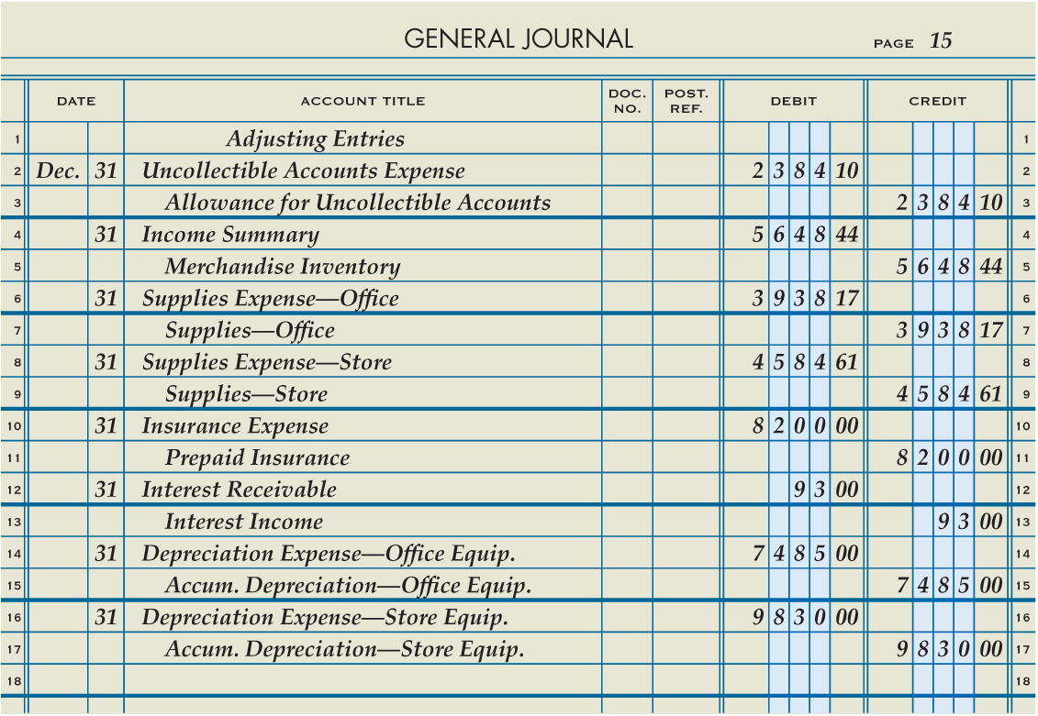
Adjusting Entries
Lesson 15-4
LO7

Slide 39
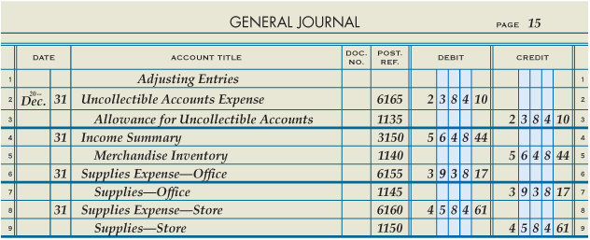
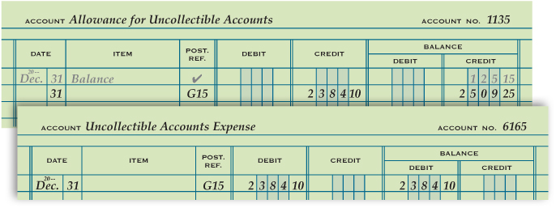
Posting Adjusting Entries
Lesson 15-4
LO7
3
Enter general ledger account numbers in general journal
Post the debit
1
2
Post the credit
3

Slide 40
Calculating Income Before Federal Income Taxes
Lesson 15-4
LO8
A trial balance prepared after adjusting entries are posted is called an adjusted trial balance.
The adjusting entry for Federal Income Tax Expense is an adjusting entry that is unique to a corporation.

Slide 41
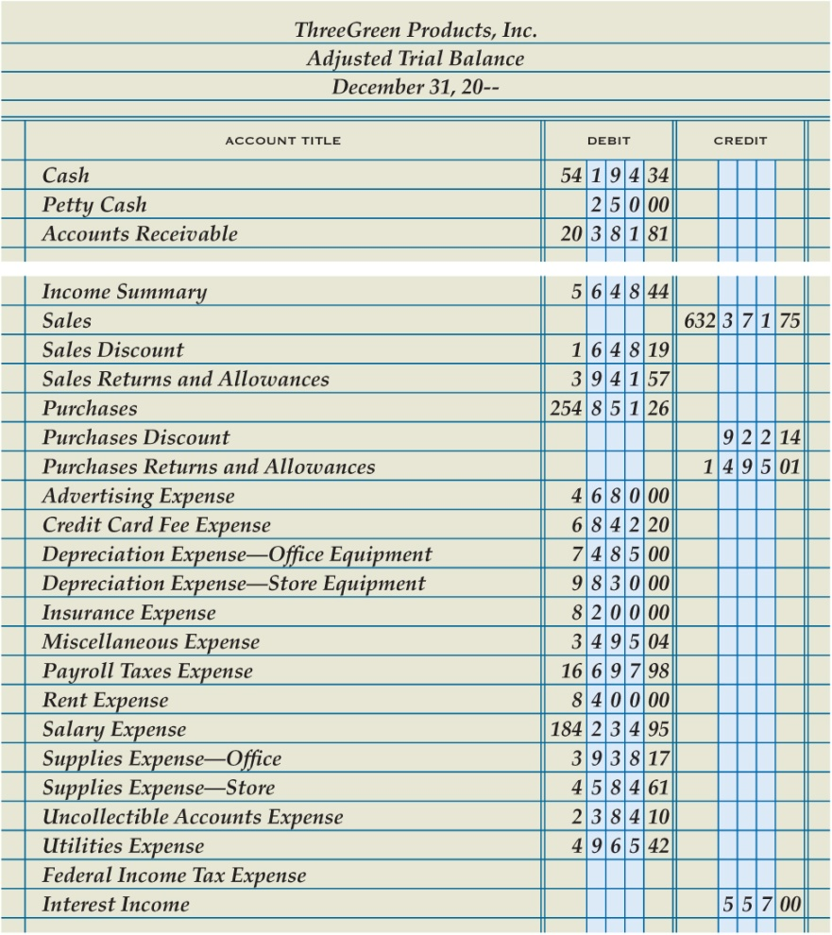
Calculating Income Before Federal Income Taxes
Lesson 15-4
LO8
1. Enter the account titles of all general ledger accounts.
1
2
2. Enter the account balances of all accounts except Federal Income Tax Expense.
3. Calculate the total account balances of income statement credit accounts. Include the account balance of Income Summary if the account has a credit balance.
4. Calculate the total account balances of income statement debit accounts, excluding the balance of Federal Income Tax Expense. Include the account balance of Income Summary if the account has a debit balance.
5. Subtract the total of debits from the total of credits to calculate net income before federal income taxes.
3
4
5
$635,345.90
−
$531,826.93
=
$103,518.97

Slide 42
Calculating Federal Income Tax
Lesson 15-4
LO8
Different tax rates are applied to different levels of net income.
Each tax rate and taxable income amount on one line of a tax table is called a tax bracket.
The tax rate associated with a tax bracket is called a marginal tax rate.

Slide 43
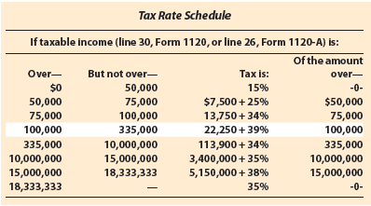
Calculating Federal Income Tax
Lesson 15-4
LO8
Net Income before Federal Income Taxes | − | Of the Amount Over | = | Net Income Subject to Marginal Tax Rate | × | Marginal Tax Rate | = | Marginal Income Tax
$103,518.97 | − | $100,000.00 | = | $3,518.97 | × | 39% | = | $1,372.40
Bracket Minimum Income Tax | + | Marginal Income Tax | = | Federal Income Tax
$22,250.00 | + | $1,372.40 | = | $23,622.40

Slide 44
Journalizing the Adjusting Entry for Federal Income Tax Payable
Lesson 15-4
LO8
1
Debit Federal Income Tax Expense
2
Credit Federal Income Tax Payable

Slide 45
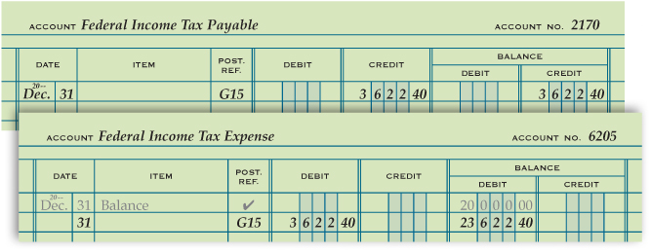
Posting the Adjusting Entry for Federal Income Tax Payable
Lesson 15-4
LO8
Post the debit to the general ledger
Post the credit to the general ledger

Slide 46
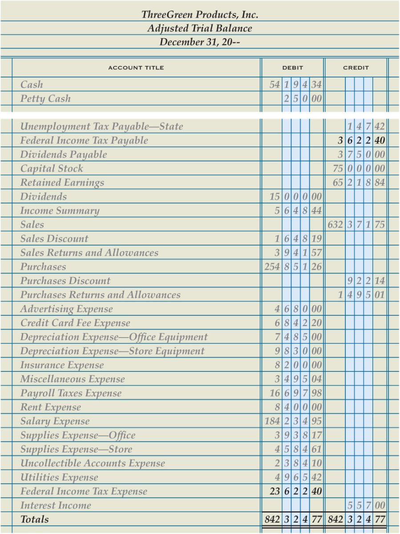
Completing an Adjusted Trial Balance
Lesson 15-4
LO9
1
Enter the adjusted balance of Federal Income Tax Payable
2
Update balance of Federal Income Tax Expense
3
Total, prove, and rule the trial balance

Slide 47
Lesson 15-4 Audit Your Understanding
Lesson 15-1
1. Which adjusting entry is unique to a corporation?
ANSWER
Federal income tax expense

Slide 48
Lesson 15-4 Audit Your Understanding
Lesson 15-4
2. In what order can the adjusting entries be journalized?
ANSWER
By the order the accounts appear in the trial balance, beginning with assets or revenue

Slide 49
Lesson 15-4 Audit Your Understanding
Lesson 15-4
3. Which accounts are totaled to determine net income before federal income taxes?
ANSWER
All income statement debit accounts, excluding federal income tax expense, and all income statement credit accounts

Slide 50
Lesson 15-4
Aplia

Slide 51
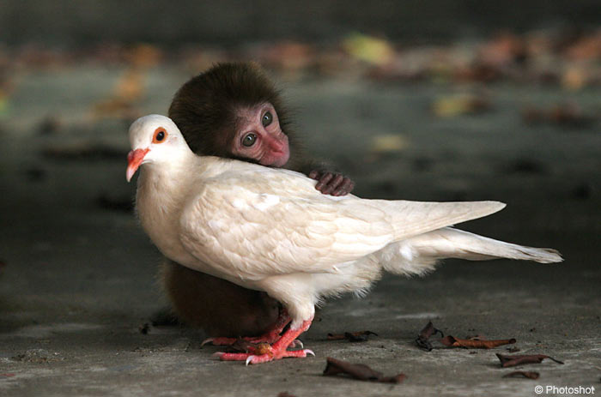

Slide 52
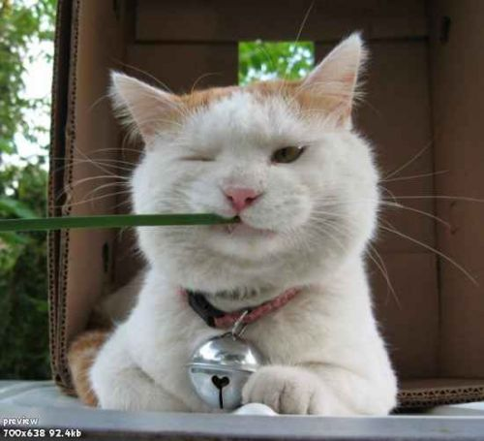

Slide 54
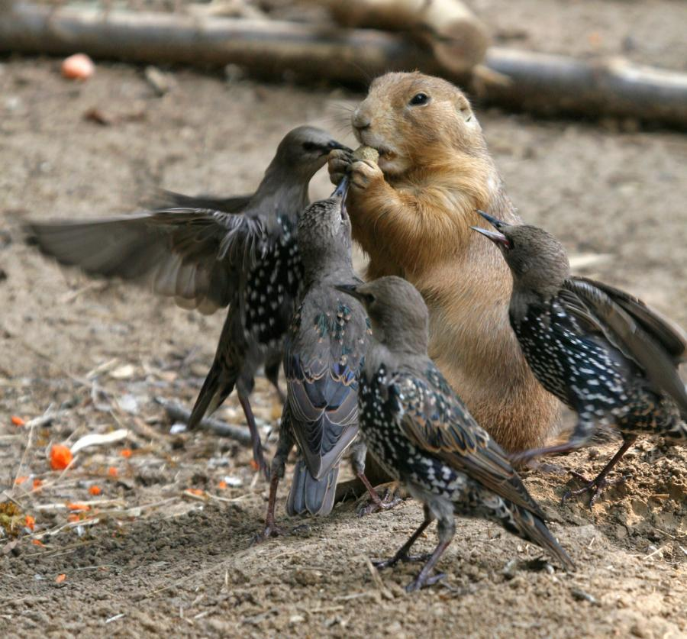

Slide 64
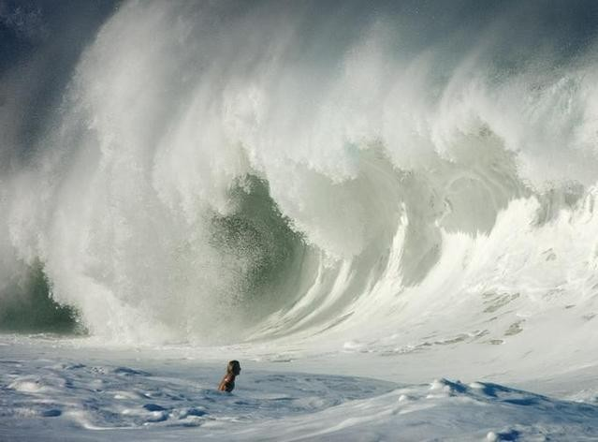

Slide 65
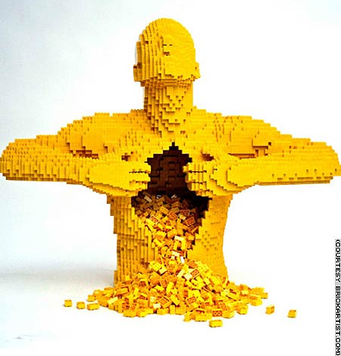

Slide 68
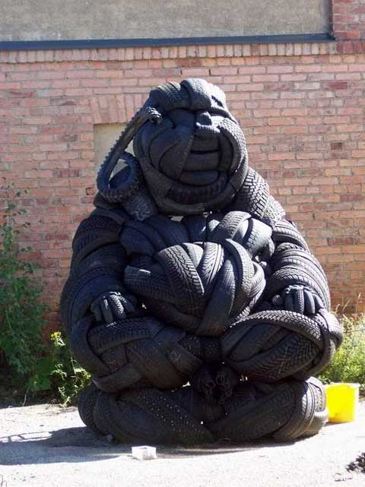

Slide 70
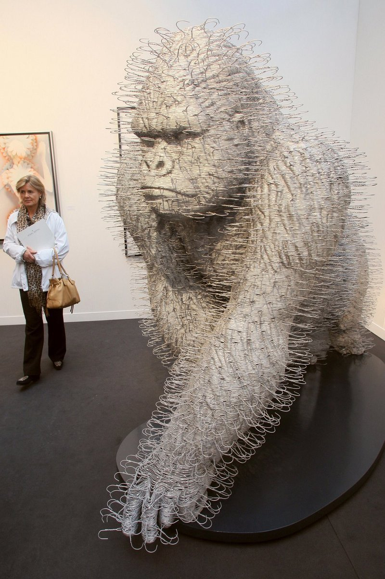

Slide 71
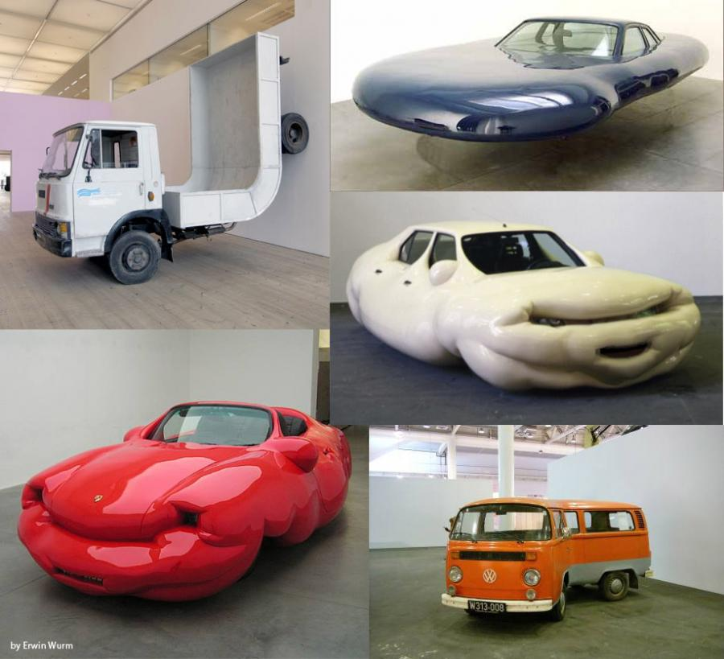

Slide 75
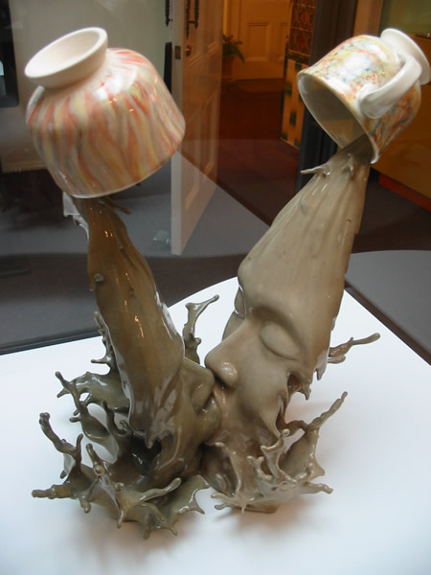

Slide 78
Preschooler Test.............
I already knew I was dumber than the fifth graders...but now it's the preschoolers.

Slide 79
Which way is the bus below traveling? To the left or to the right?

Slide 80
Can't make up your mind?
Look carefully at the picture again.
Still don't know?

Slide 81
Pre-schoolers all over the United States were shown this picture and asked the same question.
90% of the pre-schoolers gave this answer:
"The bus is traveling to the left.."

Slide 82
When asked, "Why do you think the bus is traveling to the left?“ They answered:
"Because you can't see the door to get on the bus.“

Slide 83
The End

